Slide 1
Iteration 1
By: Bienenkönigin (Queen Bees)

Slide 2
Narrative
Problem Statement: Cardinal Cupboard currently contains few features for visitors to access such as a Donations and Volunteers page. Our goal is to create a redesigned website that is easy-to-use with streamlined business processes.
Business Case: The Cardinal Cupboards purpose is to aid students & faculty that may not be able to afford some day-to-day products. Giving the website a new look can give people to talk about.
Feasibility Considerations: Analysis project's relevant factors including technical, economic, and organizational.
User friendly website with advance features.
Free or low cost ( affordable ) required resources, yet high quality. WordPress and Stripe .
Help organization to increase revenue and attract more users. .

Slide 3
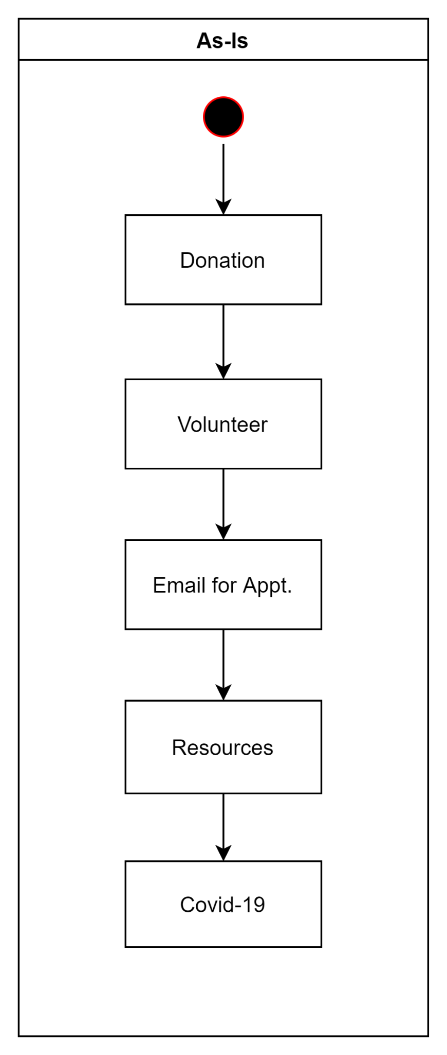
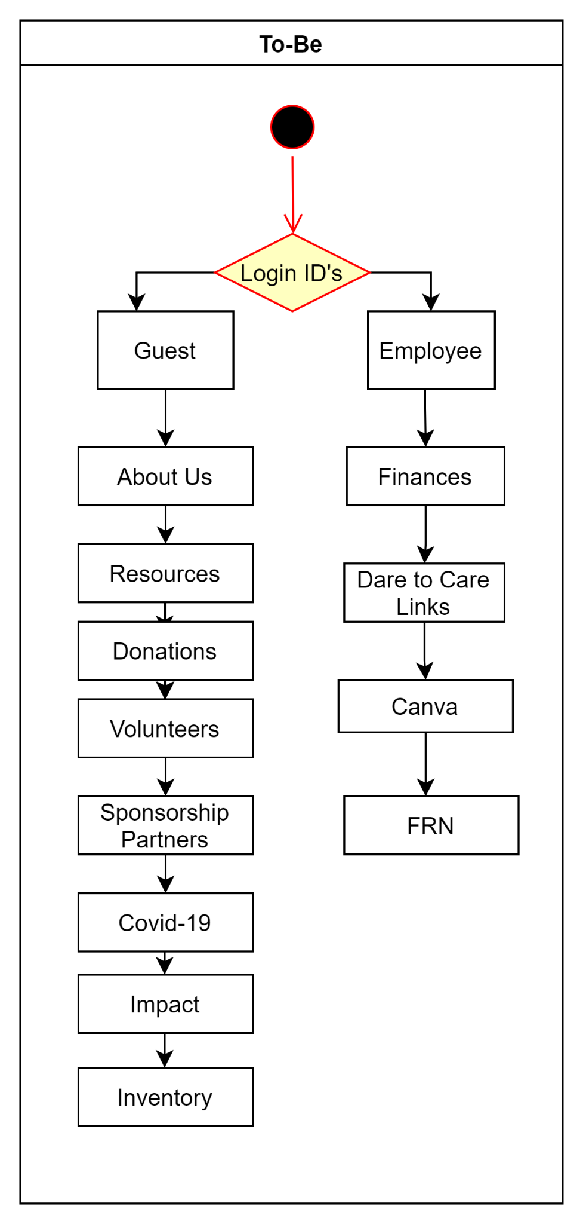
Process Models

Slide 4
Agile Stories
Monitor Inventory
Securely and easily make payments
Convenience website
Accurate Information

Slide 5
System Request
Project Sponsor: | Dr. Barker and Cardinal Cupboard
Business Need: | To create a redesigned website that is user-friendly with streamlined business processes
Business Requirements: | Provide resources for volunteer and donation opportunities Provide data on Cardinal Cupboard’s impact Provide links to social media and staff emails Provide an inventory management system to both employees and guests that displays the goods available Provide an “About Us” section with the mission statement
Business Value: | Increase expected $100,000 annual donations by 2-4% by increasing the number of visitors to the website, and providing a quick and easy way to make payments Currently there is no accurate data on number of visitors to the website Increase the amount of food diverted from landfills by 2% by adding 2-3 additional food recovery locations on/near campus. This will be achieved by implementing a system for restaurants/events on campus to report leftover food directly to the Cardinal Cupboard
Special Issues or Constraints | Acquiring a low-cost or free inventory management system- as current IT expenses are $0

